Slide 1

SIG718 - Real World Analytics Mid-Term Assignment
Name: B Priyankaa
Student ID: s224207694

Slide 2

ABOUT THE DATASET:
This experimental dataset is about the humidity and temperature conditions that were monitored by a wireless sensor and averaged for about 10 minutes.
The energy data and weather station data were merged by Data&Time columns in order to get experimental data.
The Dataset for this assignment is a modified version of a subset of data used in Candanedo et al, 2017. The experimental data have been used to create models of energy use of appliances in a low-energy house.
The modified Dataset provides the energy use of Appliances (denoted as Y) using 671 samples. The Dataset comprises 5 features (variables), which are denoted as X1, X2, X3, X4 and X5.
The details about these variables are given below:
X1: Temperature in kitchen area, in Celsius
X2: Humidity in kitchen area, given as a percentage
X3: Temperature outside (from weather station), in Celsius
X4: Humidity outside (from weather station), given as a percentage
X5: Visibility (from weather station), in km
Y: Appliances, energy use, in Wh'.

Slide 3

TASK 1:
Initially, the working directory is first set on the R working space.
The libraries like readr, knitr, rmarkdown are all set.
The dataset "ENB_2023.txt" is initially is read and assigned as a matrix to a variable named: the.data
Out of 671 data entries, only a subset of 340 is grouped and stored in the name: my.data
Also, the columns on the dataset are changed as per requirement and stored with the variable name: my.data.df
Generally Scatter Plots are used to display relationship between the 2 numerical columns. 5 Scatter plots for the variables X1, X2, X3, X4, X5 against Y are created.
Inferences are also made on each variable against Y based on these scatter plots.

Slide 4
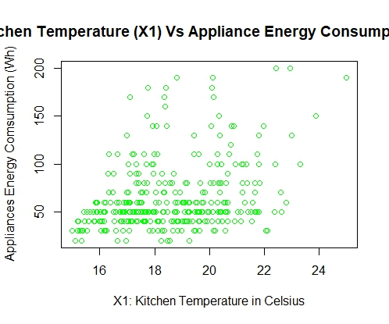
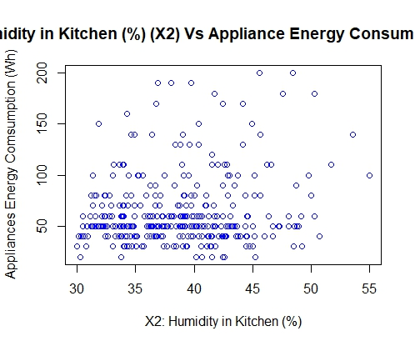

TASK 1: SCATTER_PLOTS AND INFERENCES
Energy consumption by the appliance is high when Kitchen Tempertaure is high, here Wh is higher between 17 to 21 degree Celsius.
Energy consumption by the appliance is high when Humidity in the Kitchen ranges between 32 - 43%.

Slide 5
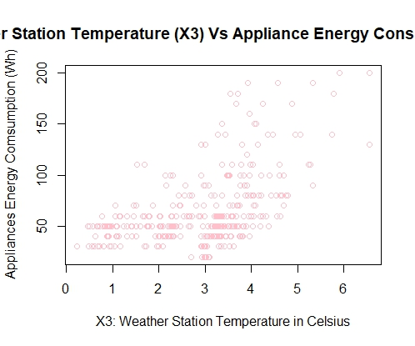
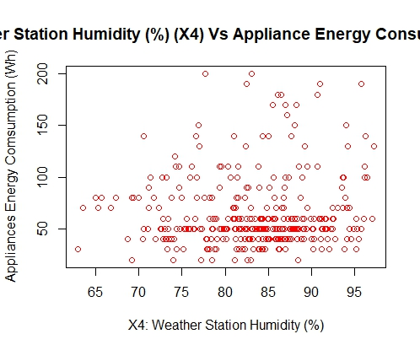

TASK 1: SCATTER PLOTS AND INFERENCES
Energy consumption ranges from 20 - 110 Wh when the Tempertaure of the Weather Station ranges from 1 - 4 degree Celsius.
Appliance's Energy Consumption ranges from 30 - 100 Wh for the Weather Station's Humidity ranging between 73 - 91 %.

Slide 6
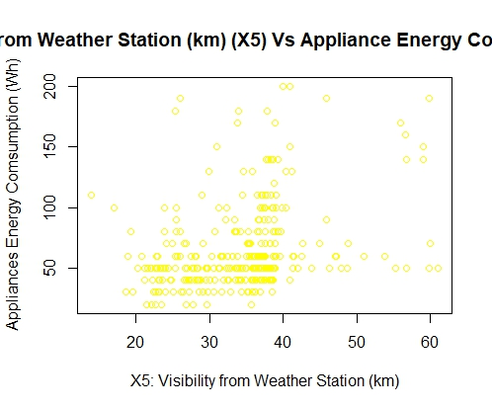
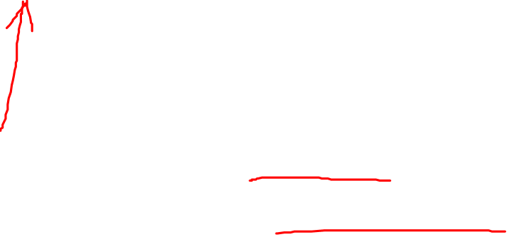
TASK 1: SCATTER PLOTS AND INFERENCES
Most of the datapoints has Energy Consumption ranging between 20 - 100 Wh for Visibility ranging between 25 - 40 km.

Slide 7
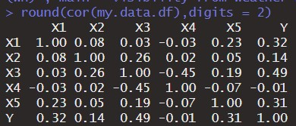

CORRELATION AND SKEWNESS OF RAW DATA
X1: Value is 0.32 which means it is moderate degree positive correlation and the data is normally distributed.
X2: Value is 0.14 which means it is low degree positive correlation and the data is positively skewed.
X3: Value is 0.49 which means it is high degree positive correlation and the data is normally distributed.
X4: Value is -0.01 which means it is non-linear correlation and the data is negatively skewed.
X5: Value is 0.31 which means it is low degree positive correlation and the data is positively skewed.

Slide 8
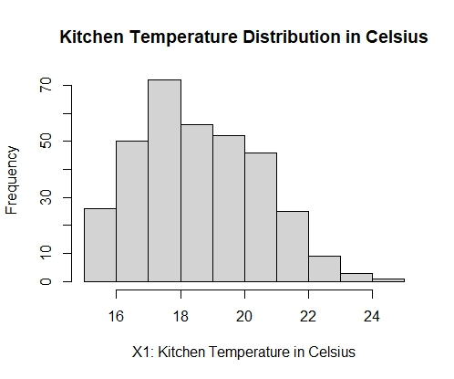
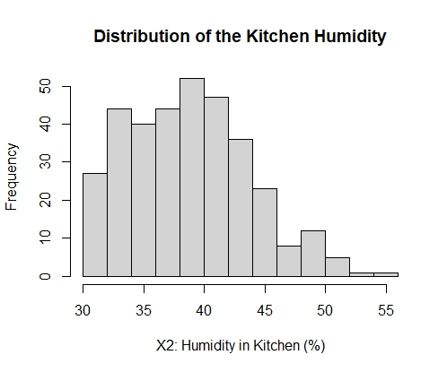
TASK 1: HISTOGRAM AND INFERENCES
Inference: The highest frequency is reached for the Kitchen Temperature ranging from 16 - 18 degree Celsius.
Inference: The highest frequency is reached for the Kitchen Humidity ranges from 32 - 43%.

Slide 9
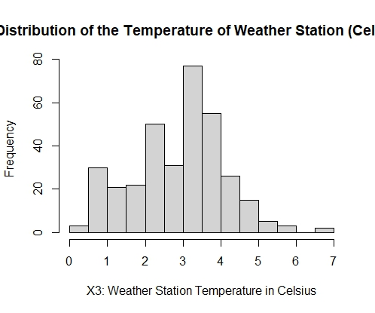
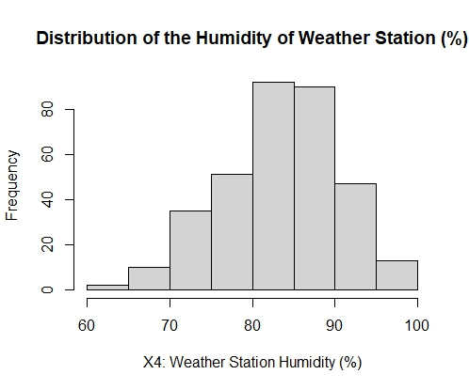

TASK 1: HISTOGRAM AND INFERENCES
Inference: The highest frequency of the Temperature of the Weather Stations is 3 - 4 Celsius.
Inference: The highest frequency for the Weather Station Humidity ranges from 75 - 90%.

Slide 10
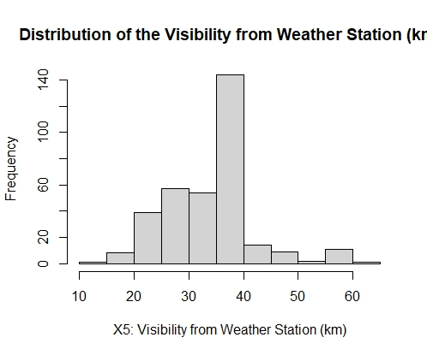
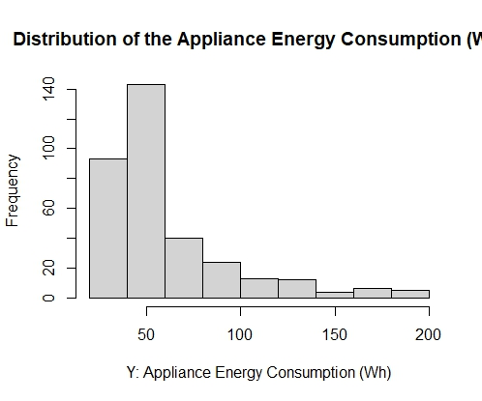
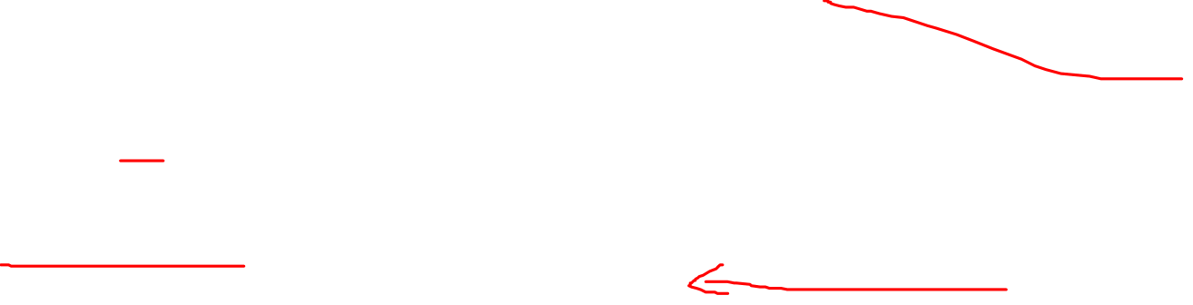
TASK 1: HISTOGRAM AND INFERENCES
Inference: The highest frequency for the Distance from Weather Station ranges between 35 - 40 km.
Inference: From the histogram, it seems that most appliances consumes less energy ranging between 20 - 70 Wh. There are very few appliances consuming higher energy of above 120 Wh.

Slide 11

TASK 2: TRANSFORMATIONS ON DATA
Each column may represent certain things that are measured differently through different scales.
In order to bring uniformity, these variables are scaled to 0 - 1 scale through transformations so that it can compared easily.
Out of 5 variables, 4 variables are chosen that is except X4, remaining variables are chosen.
X1 and X3 Variable is transformed using linear feature scaling.
This is done in order to make our analysis easier.
When the data is mostly moderately skewed, this scaling is performed.
FORMULA FOR LINEAR SCALING:
(Xold – Xmin)/ (Xmax – Xmin)
Where
Xmax is maximum value of X in column X.
Xmin is the minimum value of X in column X.
Xold is each value that’s present in the column.

Slide 12

TASK 2: TRANSFORMATIONS ON DATA
X2 and X5 Variable is transformed using polynomial and linear feature scaling.
This is done in order to make our analysis easier.
When the data is mostly positively skewed, this scaling is performed.
When there are fewer positive skew values and negative skew values, this polynomial transformation is done.
Why X4 is not chosen? X4 is not chosen because the variable has value is -0.01 which means it is non-linear correlation and the data is negatively skewed.
FORMULA FOR POLYNOMIAL TRANSFORMATION:
Polynomial transformed X value = (X)^(1/p)
Here p is taken as 100.

Slide 13

TASK 2: TRANSFORMATIONS ON DATA
Output Y Variable is transformed using log and linear feature scaling.
This is done in order to make our analysis easier.
When the data is mostly exponentially distributed, this scaling is performed.
When there are fewer positive skew values and negative skew values, this polynomial transformation is done.
The log function is useful when the data has larger inputs.
FORMULA FOR LOG TRANSFORMATION:
Y transformed log value = log 10 (Y)
These transformations mostly done on the extremely skewed dataset, so that it becomes normally distributed.
The column names are then changed and it is stored in the "BPriyankaa_Transformed.txt" file

Slide 14

ERROR MEASURES AND CORRELATION COEFFICIENTS
MODEL NAME | RMSE | Av. ABS ERROR | Pearson correlation | Spearman correlation
Weighted Arithmetic Mean (WAM) | 0.2051 | 0.1642 | 0.3389 | 0.3917
Weighted Power Means (WPM) with p = 0.5 | 0.2184 | 0.1755 | 0.3290 | 0.3808
Weighted Power Means (WPM) with p = 2 | 0.1900 | 0.1492 | 0.3314 | 0.3828
Ordered Weighted Averaging function (OWA) | 0.1734 | 0.1341 | 0.3229 | 0.3704
The Choquet Integral | 0.1685 | 0.1296 | 0.3461 | 0.3956

Slide 15
INFERENCE BASED ON WEIGHTS, ERRORS AND COEFFICIENTS
Weighted Arithmetic Mean (WAM): Better fitting is achieved for functions where the output variable in the data does not tend toward the lower inputs. The most influential/useful variable in predicting the output is X1.
Weighted Power Means (WPM) with p = 0.5: Better fitting is achieved for functions where the output variable in the data tends toward the higher inputs. The most useful variable in predicting the output is X1.
Weighted Power Means (WPM) with p = 2: Better fitting is achieved for functions where the output variable in the data does not tend toward the lower inputs. The most useful variable in predicting the output is X4.
Ordered Weighted Averaging function (OWA): The lowest input is allocated the lowest weight. The most useful variable in predicting the output is X4.
The Choquet Integral: Better fitting is achieved for functions where the output variable in the data tends toward the higher inputs. The most influential/useful variable in predicting the output is X4.

Slide 16

INPUTS AND WEIGHTS
MODEL NAME | INPUTS | CORRESPONDING WEIGHTS
Weighted Arithmetic Mean (WAM) | X1, X2, X3, X5 | 0.4011, 0.2419, 0.1466, 0.2102
Weighted Power Means (WPM) with p = 0.5 | X1, X2, X3, X5 | 0.3882, 0.2132, 0.1813, 0.2171
Weighted Power Means (WPM) with p = 2 | X1, X2, X3, X5 | 0.2696, 0.2705, 0.1803, 0.2794
Ordered Weighted Averaging function (OWA) | X1, X2, X3, X5 | 0.0273, 0.2074, 0.1886, 0.5762
The Choquet Integral | X1, X2, X3, X5 | 0.2106, 0.2142, 0.1746, 0.4004

Slide 17

BEST FITTING MODEL ON DATA
There are various model fit on the data. They are WAM, WPM, OWA and Choquet Integral.
Orness generally characterizes the aggregation function. When its above 0.5, OWA tends more towards higher inputs.
While fitting the OWA and Choquet Integral model, Orness is above 0.5 that’s almost equal to 0.77 and 0.79 respectively.
These are given X1=22; X2=38; X3=4; X4=88.2, X5=34.
Based on these, transformations are done and then based on the weights and error values, best fitting model is found.
The next step is to predict the output Y variable for each model.
For each model, the output Y is found.

Slide 18

INFERENCE ON PREDICTED AND MEASURED Y
MODEL NAME | Measured Y | Predicted Y
Weighted Arithmetic Mean (WAM) | 100 | 84.65176
Weighted Power Means (WPM) with p = 0.5 |  | 84.73534
Weighted Power Means (WPM) with p = 2 |  | 77.38821
Ordered Weighted Averaging function (OWA) |  | 68.56996
The Choquet Integral |  | 76.30156
Based on the predicted Y value, the predicted Y value of choquet integral is lesser than other model's output variable.
But the RMSE value is much smaller for CHOQUET INTEGRAL model.
Also, orness for choquet integral is 0.79.
This means that aggregation functions are tending more towards the higher inputs.
Better fitting is achieved for functions where the output variable in the data tends toward the higher inputs. The most influential/useful variable in predicting the output is X4.
So, the best model is CHOQUET INTEGRAL model.

Slide 19

REFERENCE
Luis M. Candanedo, Veronique Feldheim, Dominique Deramaix. Data driven prediction models of energy use of appliances in a low-energy house, Energy and Buildings, Volume 140, 1 April 2017, Pages 81-97, ISSN 0378-7788.
Simon James. An Introduction to Data Analysis using aggregation functions in R (2016).
Wickham H, Hester J, Bryan J (2023). _readr: Read Rectangular Text Data_. R package version 2.1.4, <https://CRAN.R-project.org/package=readr>.
Xie Y (2023). _knitr: A General-Purpose Package for Dynamic Report Generation in R_. R package version 1.45, <https://yihui.org/knitr/>.
Allaire J, Xie Y, Dervieux C, McPherson J, Luraschi J, Ushey K, Atkins A, Wickham H, Cheng J, Chang W,Iannone R (2023). _rmarkdown: Dynamic Documents for R_. R package version 2.25, <https://github.com/rstudio/rmarkdown>.
Xie Y, Allaire J, Grolemund G (2018). _R Markdown: The Definitive Guide_. Chapman and Hall/CRC, Boca Raton, Florida. ISBN 9781138359338, <https://bookdown.org/yihui/rmarkdown>.
Xie Y, Dervieux C, Riederer E (2020). _R Markdown Cookbook_. Chapman and Hall/CRC, Boca Raton, Florida.ISBN 9780367563837, <https://bookdown.org/yihui/rmarkdown-cookbook>.

Slide 20

THANK YOU

